Slide 1
Image Review
TITLE
MEDIUM
LOCATION
DATE

Slide 2
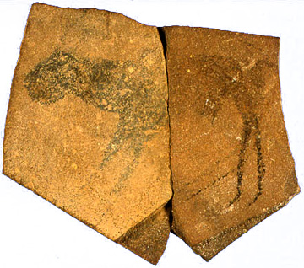

Slide 3
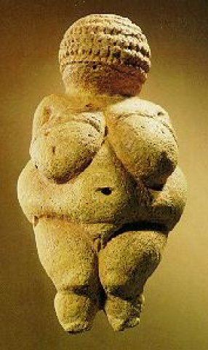

Slide 4
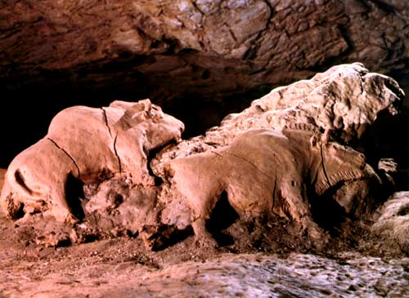

Slide 5
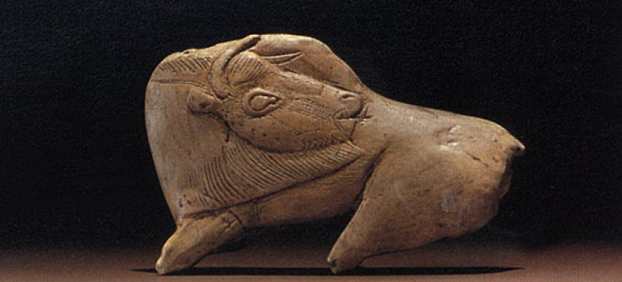

Slide 6
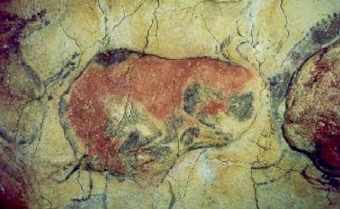

Slide 7
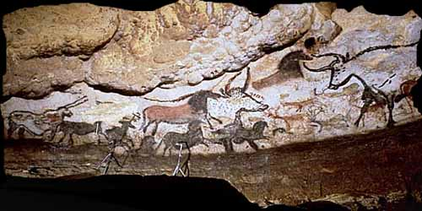

Slide 8
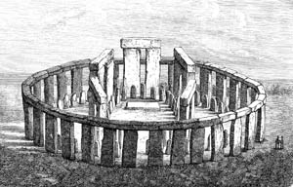

Slide 9
VOCABULARY
Paleolithic
Profile View
Composite View
Relief
Ground line
Neolithic
Cromlech
Megalith
Post
Lintel

